Slide 1

2020 Network project (practical x) presentation
MC MAHLAKWANE
217044163
CSC2B Practical X

Slide 2
Problem Statement
They’ve approached me to assist them by developing an application that will allow them to edit pictures in the simplest way possible.
.
In order to successfully continue providing their services during the fourth industrial revolution, they require software tools to help them.
.
iEscape is a company that provides printing and embroidery services for their clients and have been struggling with printing images.
.

Slide 3
solution
- The goal, for this project is to provide software tools to a printing business that sells prints that can be customized with digital images.
- To accomplish this function, a photo editor Application must be used by a user from iEscape using a computer.
- The user can modify images, adding graphics, and special effects, Then the user can save the altered photos on their local computers and then upload the images.

Slide 4
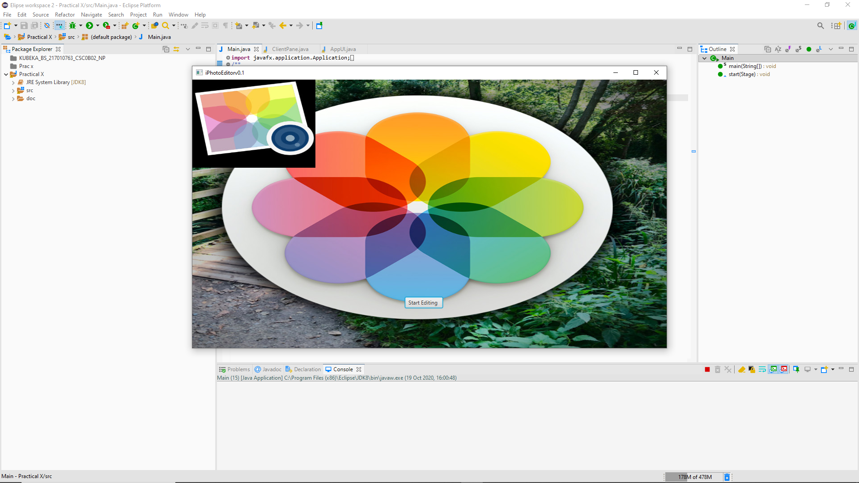
Methodology THIS WILL BE THE FIRST INTERFACE AFTER RUNNING THE APPLICATION, THE APPLICATION’S NAME IS iphotoeditor v0.1. THE USER WILL THEN HAVE TO CLICK ON THE START EDITING BUTTON TO BE ABLE TO START EDITING THE PHOTOS.

Slide 5
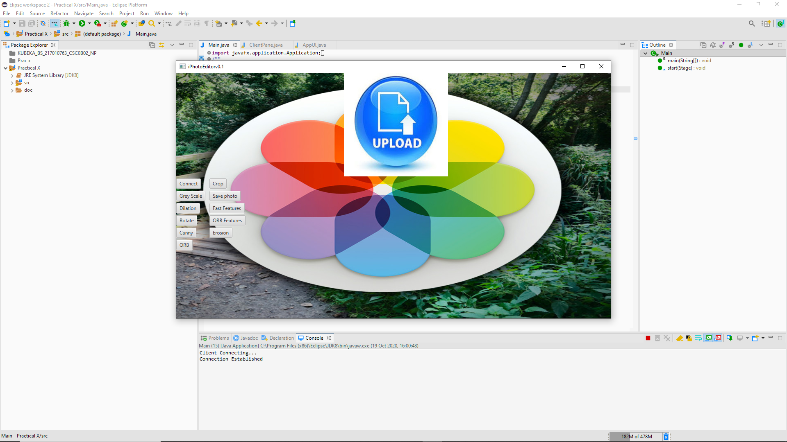
Methodology THIS WILL THEN BE THE SECOND AND LAST INTERFACE AFTER RUNNING THE APPLICATION. FROM HERE THE USER CAN START BY UPLOADING THE IMAGE THEY WISH TO EDIT BY CLICKING ON THE “UPLOAD” ICON AND THIS WILL GIVE THEM AN OPTION TO SELECT THE IMAGE THEY WISH TO EDIT AND THEY CAN EITHER CHOOSE TO GREYSCALE IT, CROP, ROTATE ETC.

Slide 6
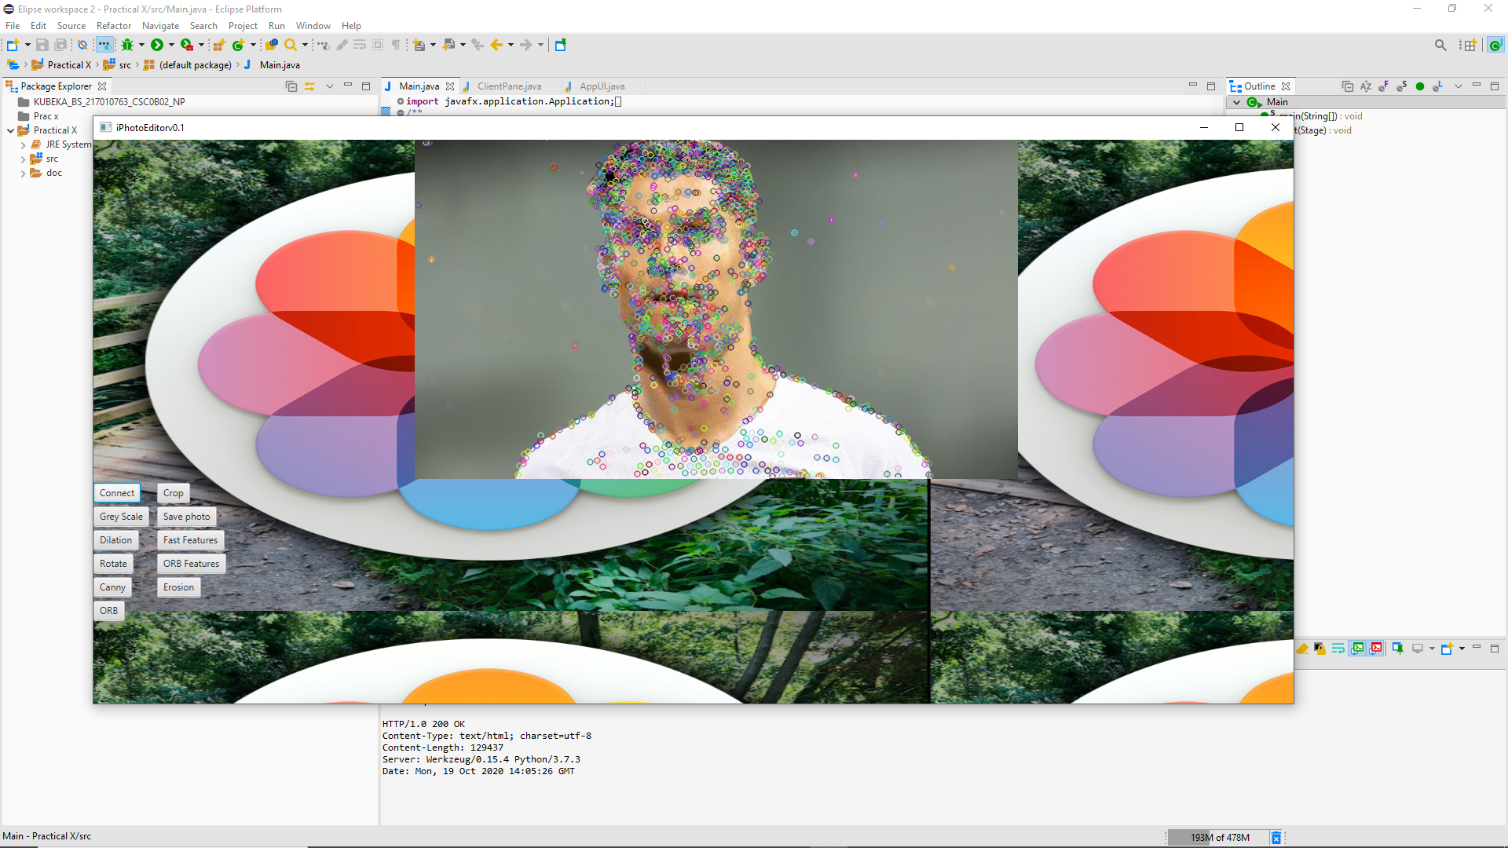
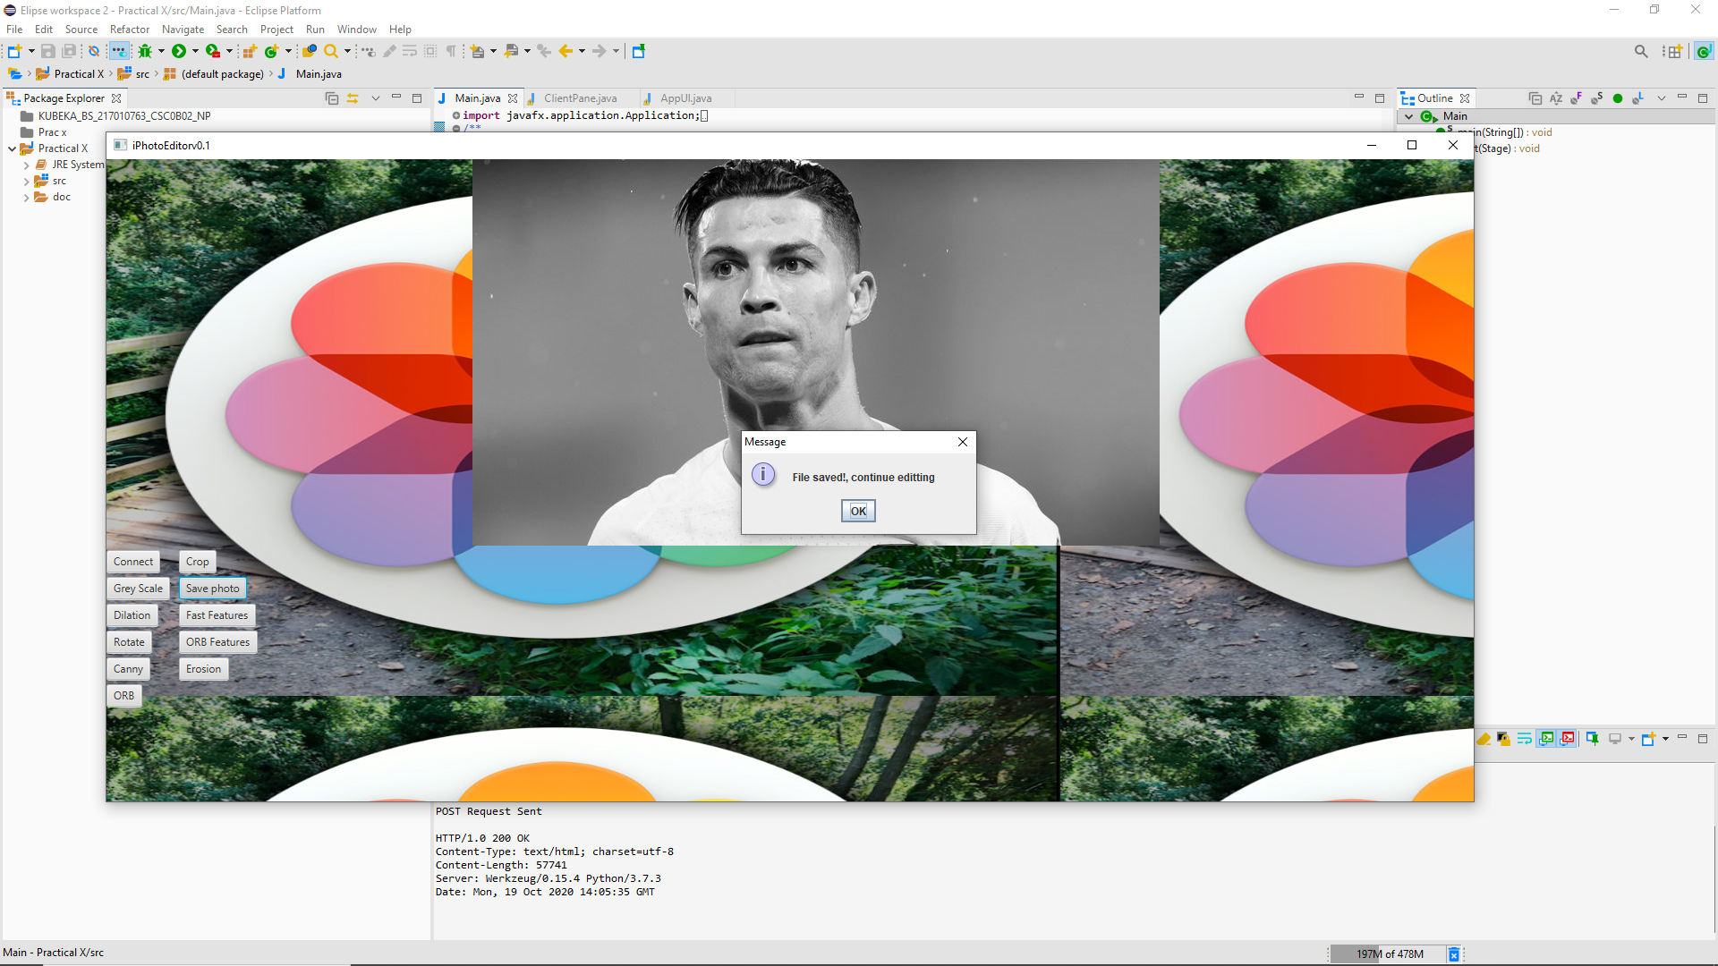
METHODODOLGY this is an example using the greyscale api function. It will darken the image using greyscale capabilities. THE USER HAS TO UPLOAD THE PHOTO, CLICK THE CONNECT BUTTON, CHOOSE THE BUTTON OF THE OPTION THEY WISH TO USE TO EDIT THEIR PHOTO AND then AFTER the user will be able to save the edited photo by clicking the save photo button.
User has to click connect button after uploading photo to be able to edit
After clicking the greyscale this will be the results and the user has to then save the photo by clicking the save photo button

